Slide 1
3A Introduction

Slide 2
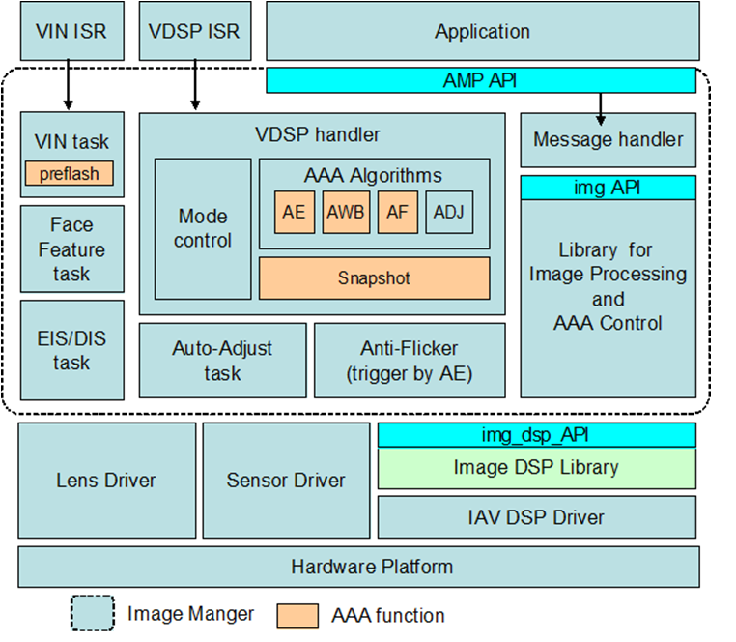

Slide 3
上图是ipc功能模块结构.通过上图,可以知道3A在整体camera框架中的功能以及与其它功能模块的相互关系.
一般上,3a通常是通过软件与硬件结合的方式实现的.如大家已知的,3a其中一块统计功能就是硬件实现的.
Auto exposure(control),自动曝光(控制).实现所采集图像,或者视频中每一帧的整体平均亮度控制在人眼观察比较舒适的程度.
Auto white balance,自动白平衡.实现不同色温环境下,所拍摄图像具有人眼的色彩一致性,或者恒常性的过程.
Auto focus,自动聚焦(自动合焦,对焦).实现自动调整相机,使得拍摄的图像较清晰的过程.
通常情况下,ipc方案商会提供外部接口,帮助客户自己实现3A或者单个算法,并嵌入到camera框架中.如下图所示:

Slide 4
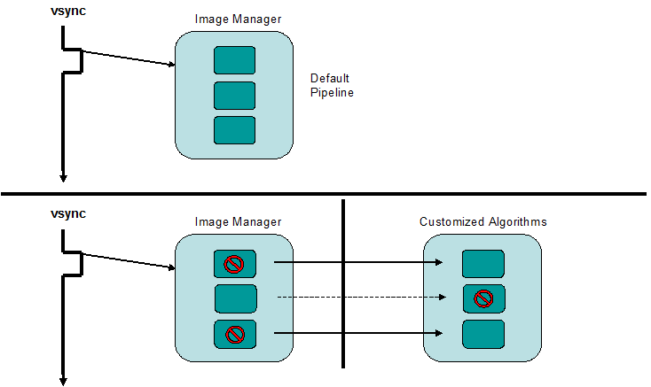

Slide 5
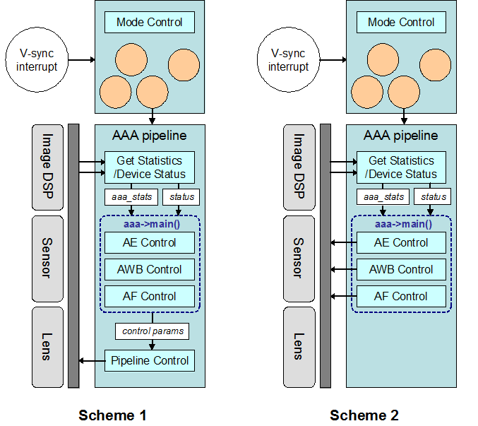

Slide 6
硬件实现部分:
AWB Statistics
The AWB Statistics are computed in CFA domain. For each tile, the statistics computed are the following
ΣR = sum of the pixel if all the pixels in that bayer quad are within [min_th, max_th] range and the pixel is red.
ΣG = sum of the pixel if all the pixels in that bayer quad are within [min_th, max_th] range and the pixel is green.
ΣB = sum of the pixel if all the pixels in that bayer quad are within [min_th, max_th] range and the pixel is blue.
Count _{max_th} = Count of bayer quads in the tile that has any of its RGB components above maximum threshold
Count _{min_th} = Count of bayer quads in the tile that has any of its RGB components below minimum threshold
The Following Statistics are collected in the YUV Doamin.
ΣY = sum of ( )the luma component.

Slide 7
AF Statistics
AF statistics are computed both in CFA as well as in YUV domain. A pseudo Luma value is generated for each pixel in the cfa domain on which the statistics are computed.
The statistics computed are the following
Focus Value1 = FV_{1,horizontal}
Focus Value2 = FV_{2,horizontal}
ΣY = sum of ( ) the pseudo luma component.
In the YUV domain, for each tile, the statistics computed are the following
Focus Value1 = weight _{1,horizontal} * FV _{1,horizontal} + weight _{1,vertical} * FV _{1,vertical}
Focus Value1 = weight _{2,horizontal} * FV _{2,horizontal} + weight _{2,vertical} * FV _{2,vertical}
ΣY = sum of ( ) the luma component.
Histogram Statistics
For each frame, following statistics are computed:
Histogram of R
Histogram of G
Histogram of B
Histogram of Y

Slide 8
typedef struct
{
unsigned short sumR;
unsigned short sumG;
unsigned short sumB;
unsigned short sumY;
unsigned short countMinThresh;
unsigned short countMaxThresh;
} idspStatsAwbTileStruct;
typedef struct
{
unsigned short sumLinY;
unsigned short sumY;
} idspStatsAeTileStruct;
typedef struct
{
unsigned short sumY;
unsigned short focusValue1;
unsigned short focusValue2;
} idspStatsAfTileStruct;
const static int IDSP_MAX_NUM_AWB_TILE_COLUMNS = 32;
const static int IDSP_MAX_NUM_AWB_TILE_ROWS = 32;
const static int IDSP_MAX_NUM_AE_TILE_COLUMNS = 12;
const static int IDSP_MAX_NUM_AE_TILE_ROWS = 8;
const static int IDSP_MAX_NUM_AF_TILE_COLUMNS = 8;
const static int IDSP_MAX_NUM_AF_TILE_ROWS = 5;
// Statistics report data structure
idspStatsAwbTileStruct_statsAwbTile[IDSP_MAX_NUM_AWB_TILE_COLUMNS * IDSP_MAX_NUM_AWB_TILE_ROWS];
idspStatsAeTileStruct_statsAeTile[IDSP_MAX_NUM_AE_TILE_COLUMNS * IDSP_MAX_NUM_AE_TILE_ROWS];
idspStatsAfTileStruct_statsAfTileCfa[IDSP_MAX_NUM_AF_TILE_COLUMNS * IDSP_MAX_NUM_AF_TILE_ROWS];
unsigned int _histogram[4][64]; // Y, R, G, B

Slide 9
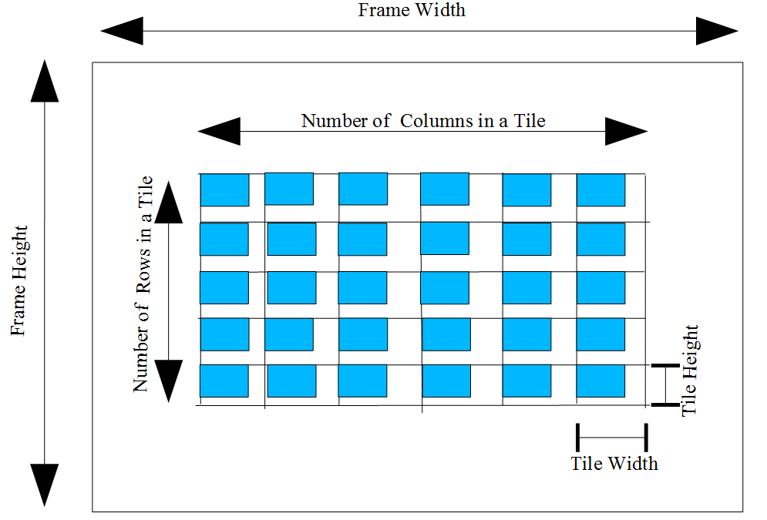
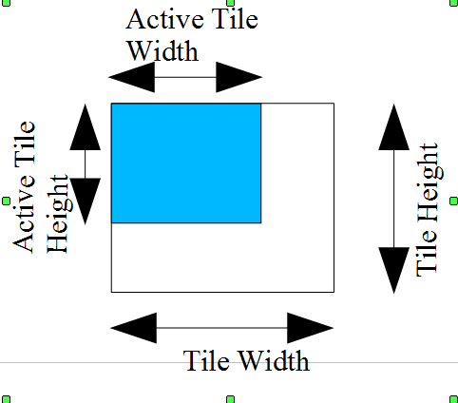

Slide 10
软件部分:
关于AE,AF,AWB的算法有很多.实现复杂.下面有简单描述.
Ae通过统计整体图像或者特定区域的直方图,根据直方图特征调整曝光时间,快门和数字增益,使得图像视频的整体平均亮度分布在一个合适的亮度区间.
Af通过统计整体图像或者特定区域的sharpness,也就是高频分量(边缘)强度,并根据高频分量的变化来驱动镜头组移动到合适的对焦位置,从而实现图像视频的清晰影像.
Awb 自适应不同色温下的色彩一致性.通常有灰度世界,完美反射算法, 动态阈值算法等简单方法,也有色温估计,色温查找表方法等.

Slide 11
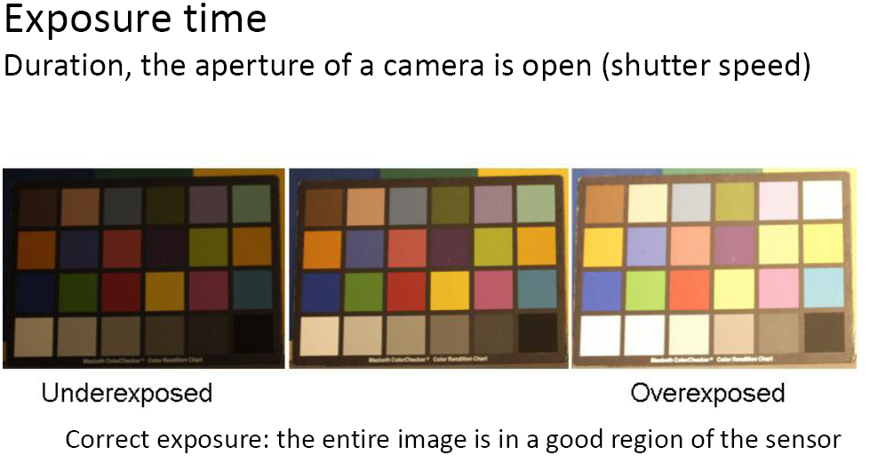
Auto exposure

Slide 12
The luminance of the image changes when the environment varies. In order to keep the luminance in the given range, we must adjust exposure time (ET) of the sensor.
If the ET is small, changing ET by one unit (one flickering period) can make the brightness of image change much. In order to make the brightness of image change smoothly, digital global gain is combined with ET adjustment

Slide 13
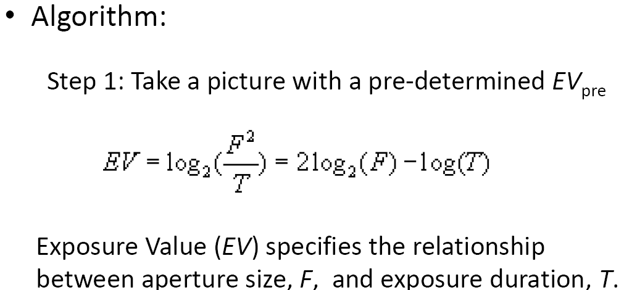
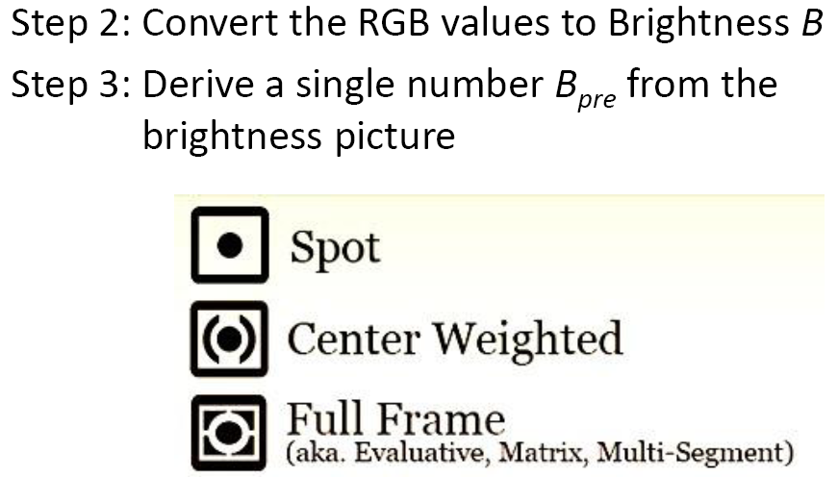

Slide 14
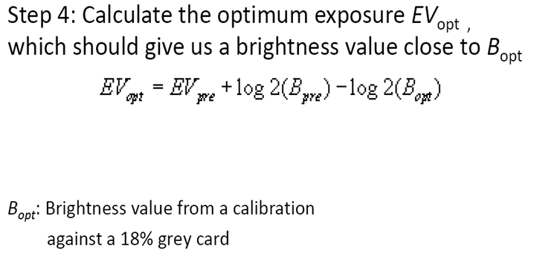
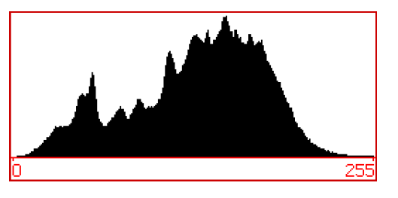

Slide 15
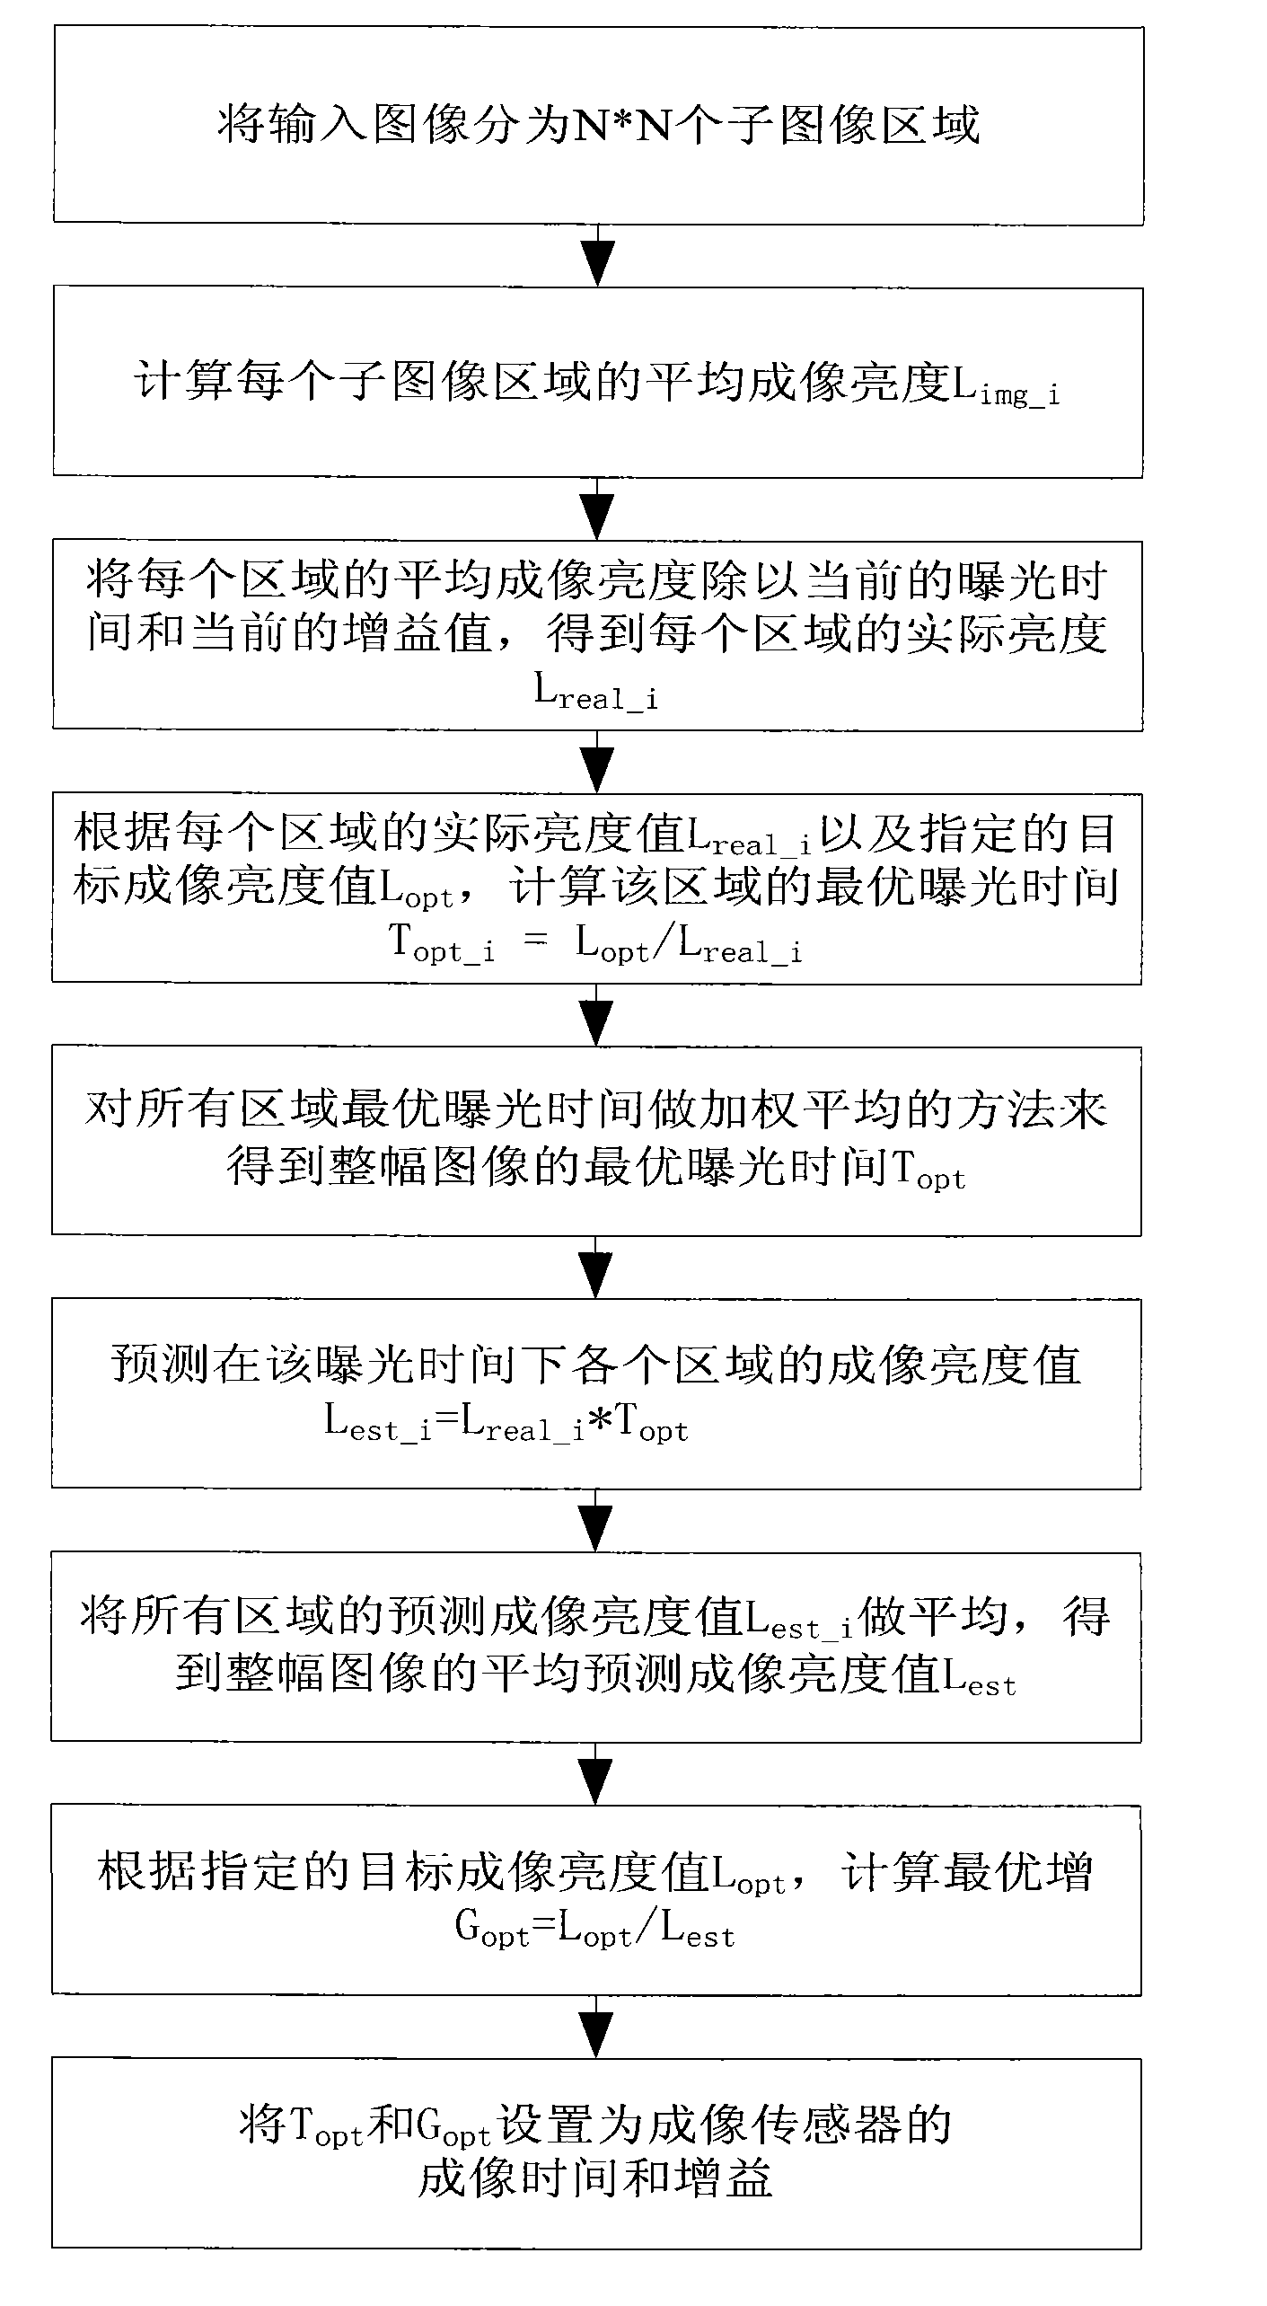

Slide 16
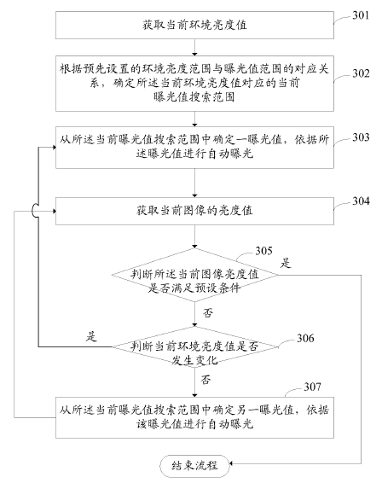

Slide 17
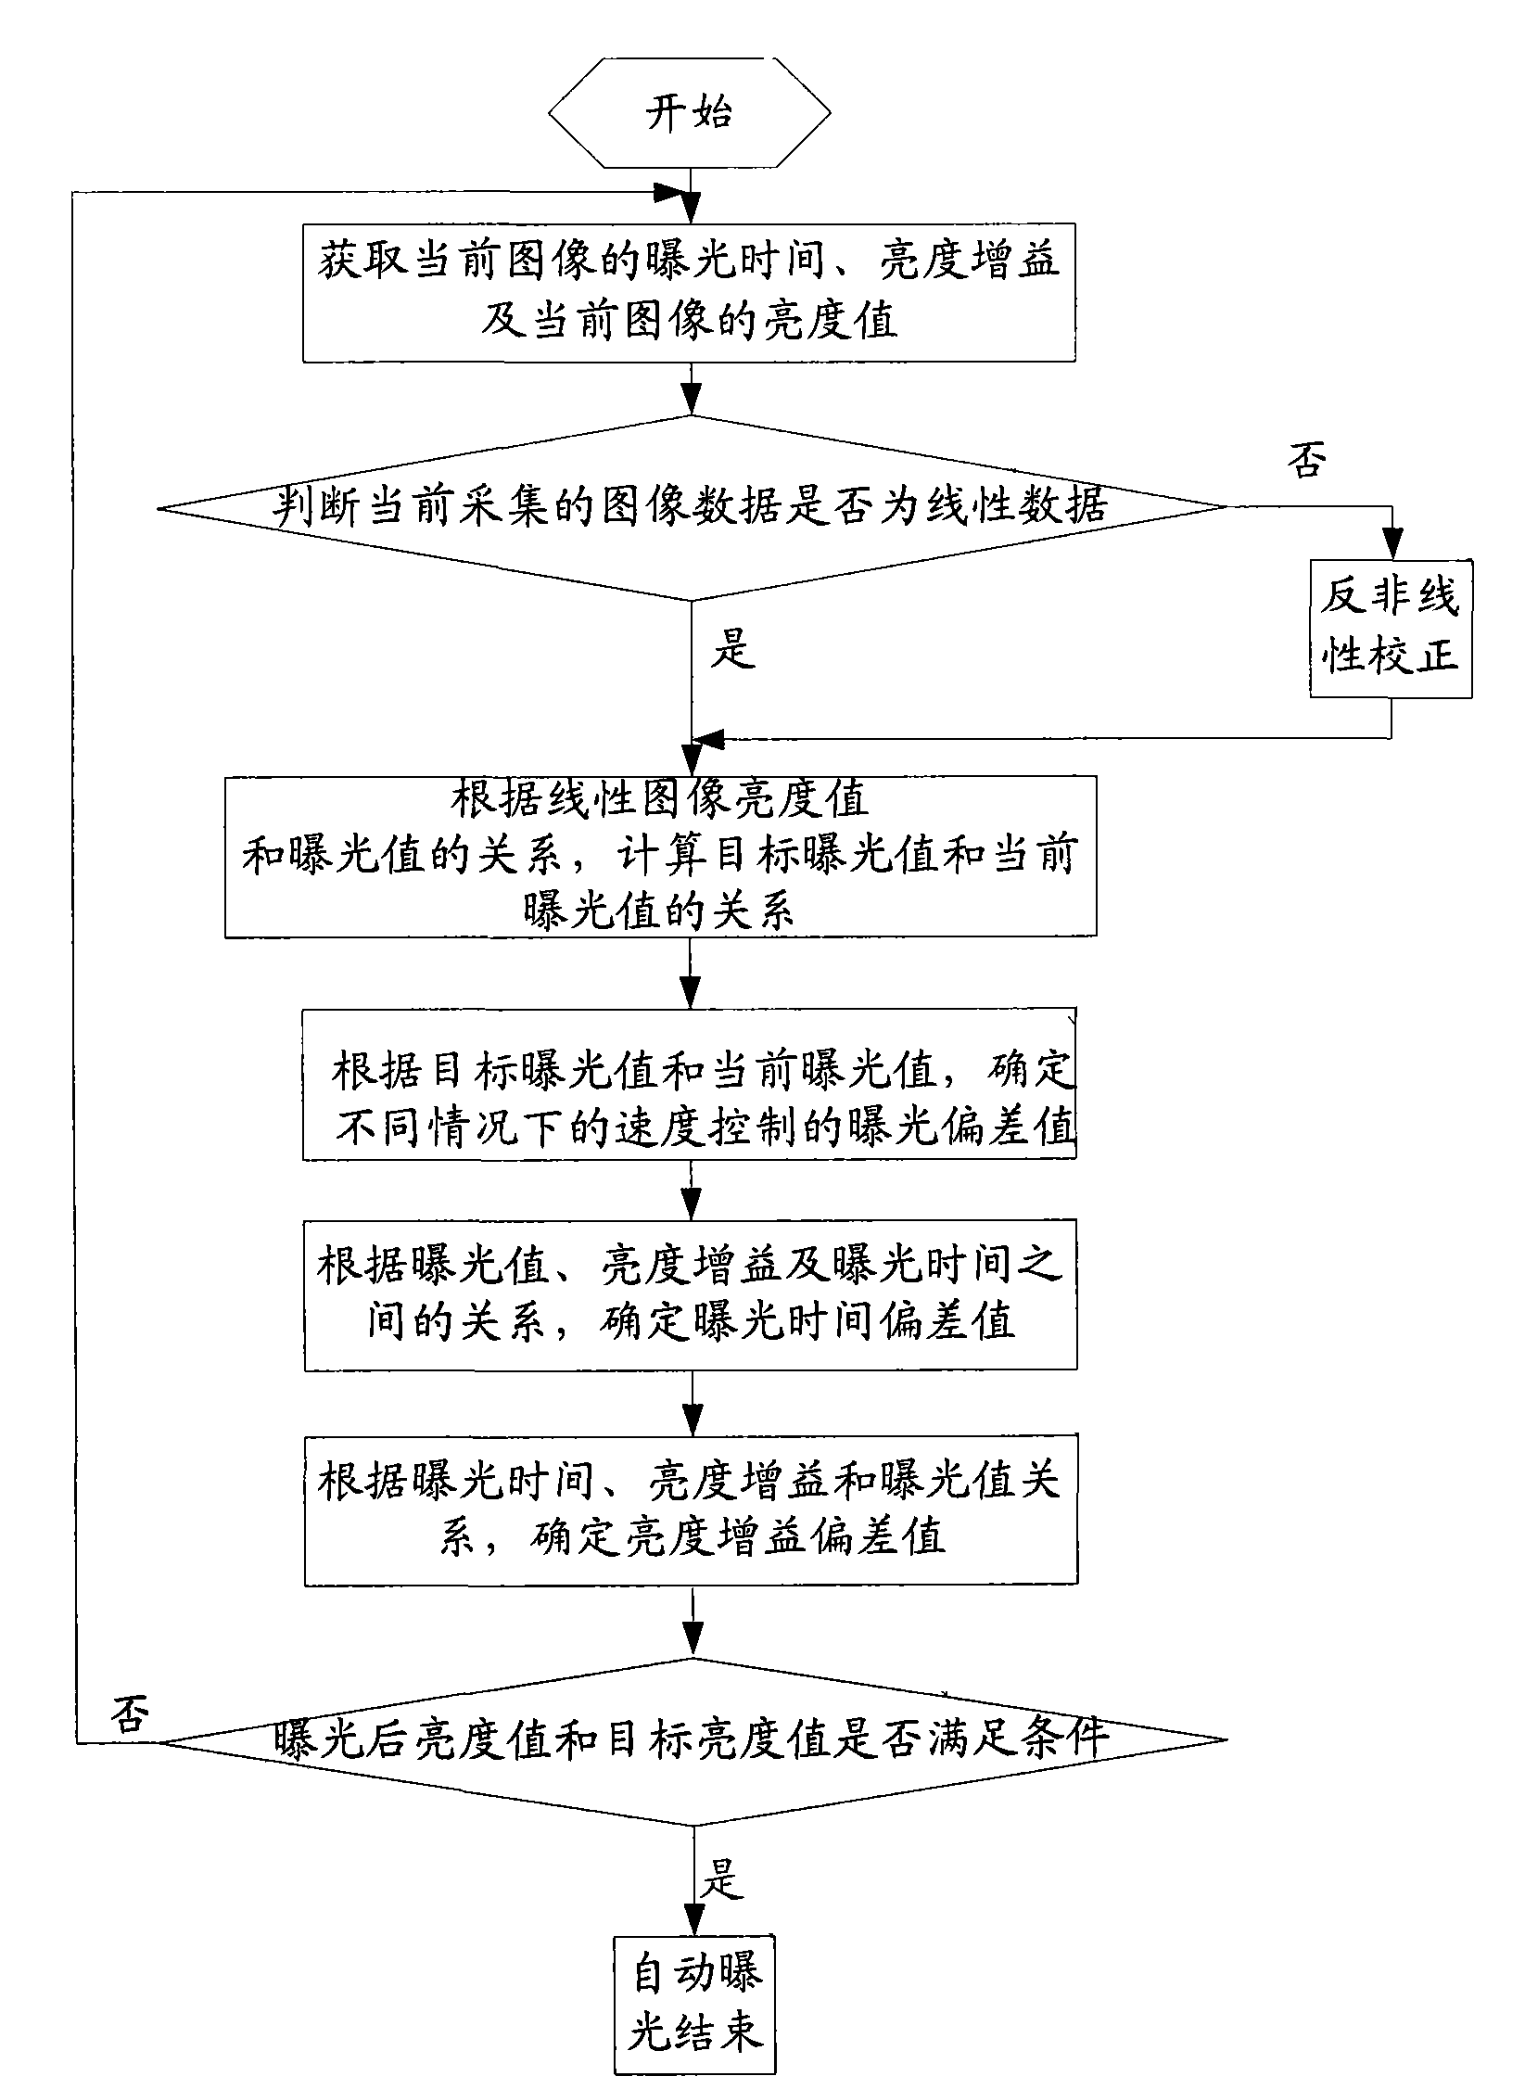

Slide 18

曝光值EV的数学定义如下：
其中N指的是镜头的光圈值，t是曝光时间，单位是秒。根据这个公式很容易的就能推导出当光圈是f1.0曝光时间是1秒的时候EV值就是0。当然曝光时间越短，f数值越大其实曝光量越小，（EV值反而大了），曝光时间越长，f数值越小曝光量其实越大（当然EV值反而变小了）。因为是以2为底的对数，所以相邻两个EV值之间的实际曝光量的差异是1倍。

Slide 19
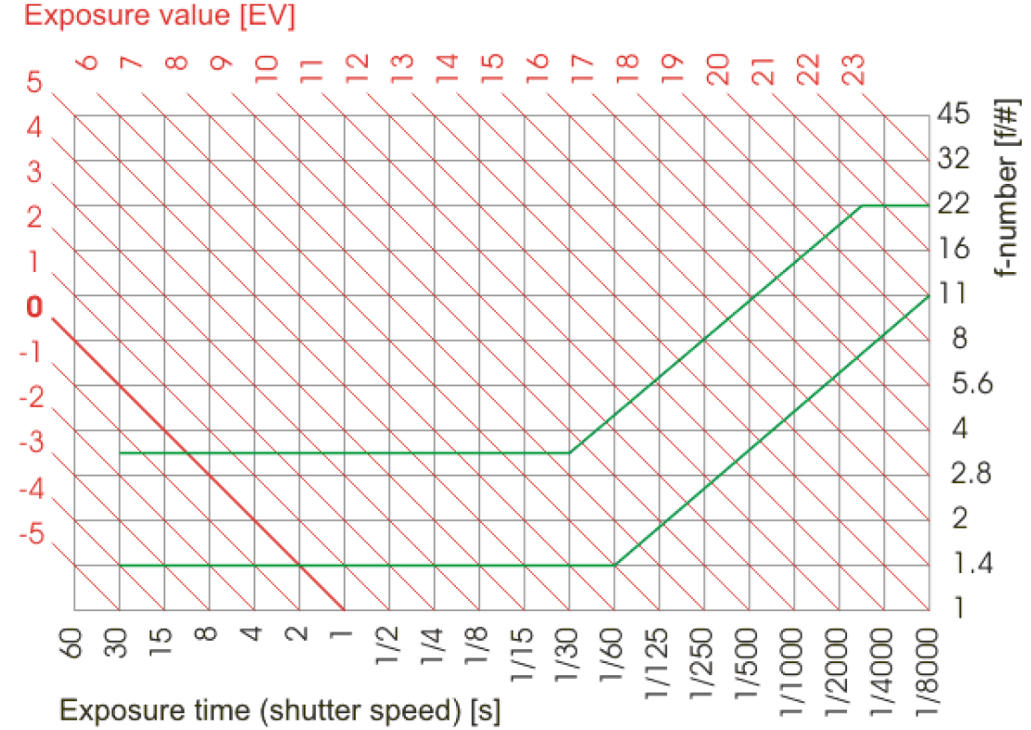

Slide 20
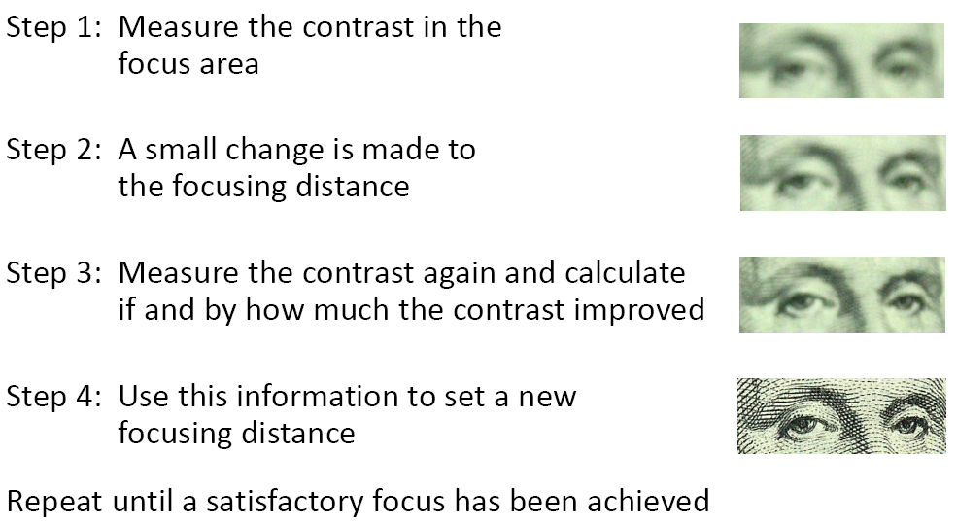
Auto focus(1)

Slide 21
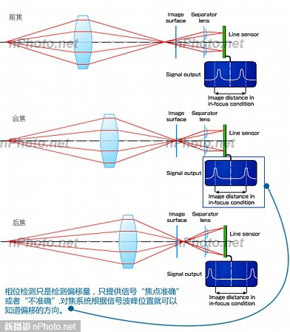

Slide 22
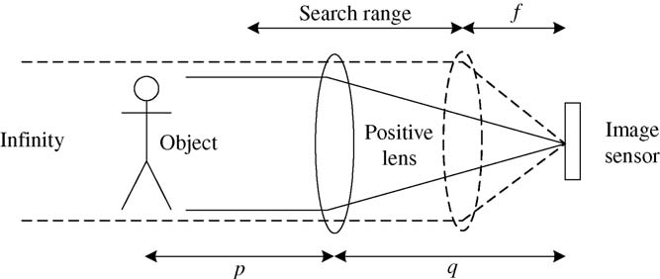

Slide 23
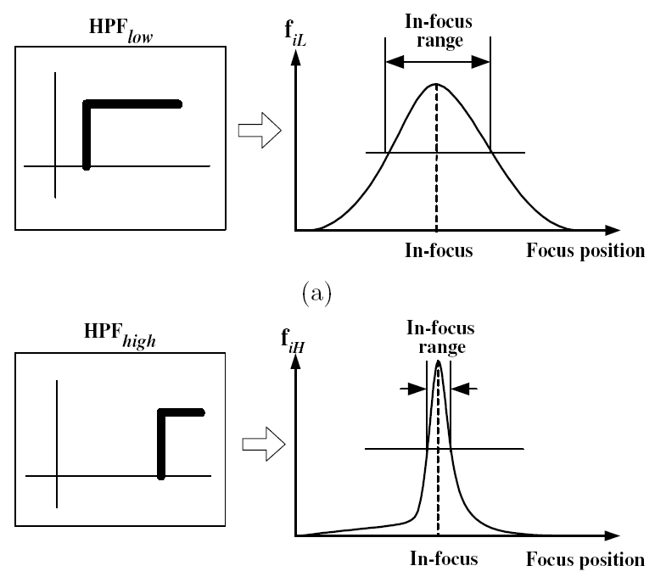

Slide 24
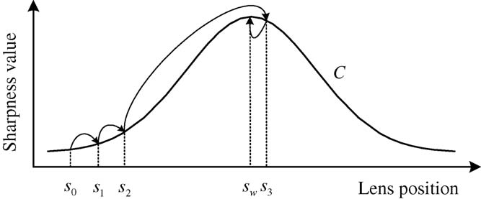
Passive auto-focus (PAF) is a technique to find the best focused lens position without active component.
A good sharpness measurement algorithm should obtain the higher sharpness value for the proper lens position to a well-focused image than an improper one.

Slide 25
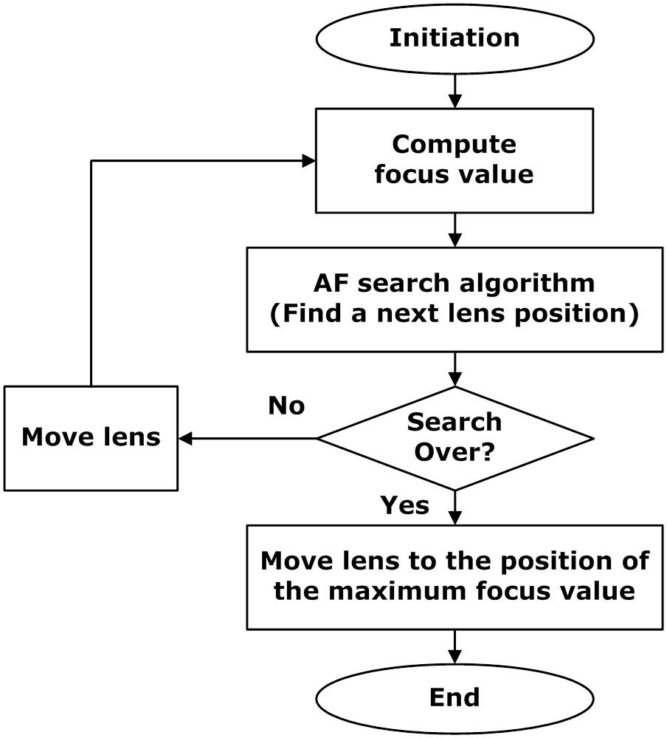

Slide 26
Auto focus(2)
三次曲線與二次曲線近似演算法
二次曲線與三次曲線近似演算法的實作方法可分為以下幾個步驟
Step 1: 移動取像直到△y發生正負變化
依據對焦量測準則結果的清晰度曲線分佈特性，我們將顯微鏡馬達每次的移動量（Moving Step）暫訂為顯微鏡馬達總行程的五分之一，開始移動取像並計算其對焦量測準則數值，紀錄上述的取像位置x與對焦量測準則數值y直到△y發生正負變化。
Step 2: 三次多項式近似
下式為三次多項式的數學表示式。若△y發生正負變化，則將之前所紀錄資料中對焦量測數值較大的前四筆變化資料取出來用Newton polynomial form建立可以表示此四筆資料分佈特性的三次多項式

Slide 27
Search Method
Step 3: 三次多項式求解
在數學上，三次多項式可以透過一次微分等於零f?x)=0的方式來求的兩相異實根，一次微分等於零是在找切線斜率等於零的點。而三次曲線一次微分等於零的二點之中，其中一點就是我們在找的對焦點。
Step 4: 二次多項式近似
下式為二次多項式的數學表示式。將顯微鏡馬達移動到上次多項式近似時所求得的對焦點，取像並計算其對焦量測準則數值，將其紀錄資料中對焦量測數值較大及其左右二筆共三筆變化資料取出來用Newton polynomial form建立可以表示此三筆資料分佈特性的二次多項式。

Slide 28
Step 5: 二次多項式求解
使用矩陣解法可以求得二次多項式的係數a、b及c，依據圖形曲線分佈得知其為一拋物線，我們可以用矩陣方式求解並以頂點公式 求得對焦點的位置。
Step 6: 判斷是否已經找到正確的對焦位置
將顯微鏡馬達移動到二次多項式近似時所求得的對焦點，取像並計算其對焦量測準則數值，將其取像位置及其對焦量測數值紀錄下來，並判斷其對焦位置是否與之前計算出的位置一樣，若一樣則表示已找到正確的對焦位置，若否，則繼續重複步驟4和步驟5。

Slide 29
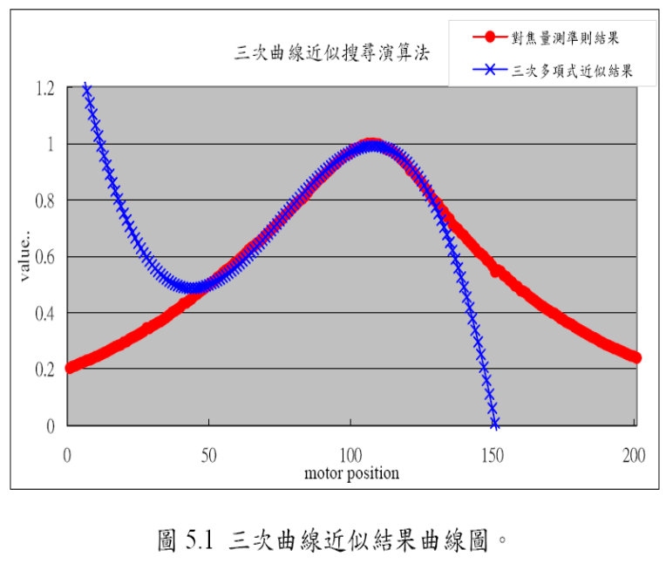

Slide 30
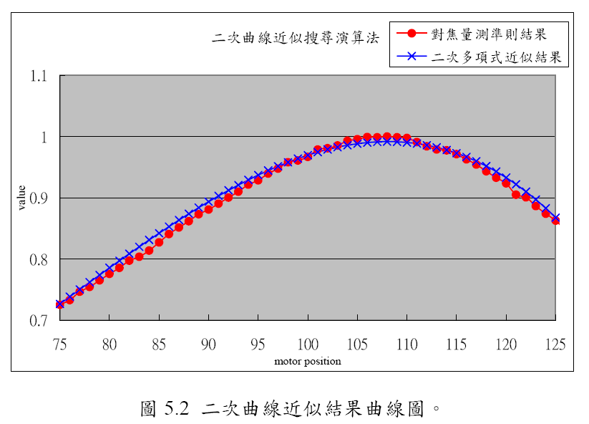

Slide 31
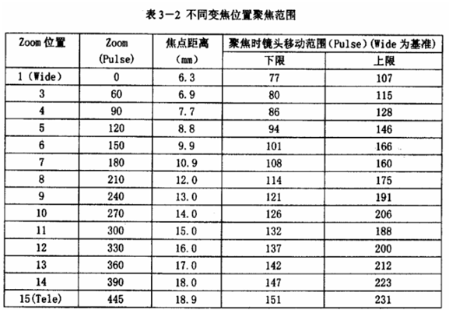

Slide 32
Auto White Balance
When the white paper moves from one light source to another light source, an image sensor sees different colors under different conditions. Similarly, when a digital camera is moved from outdoors (sunlight) to indoor fluorescent (or incandescent) light conditions, the color in the image shifts.
To correct for light source color-temperature changes, the balance among red, green and blue has to be shifted. This “white balancing” is performed by the algorithm below.

Slide 33
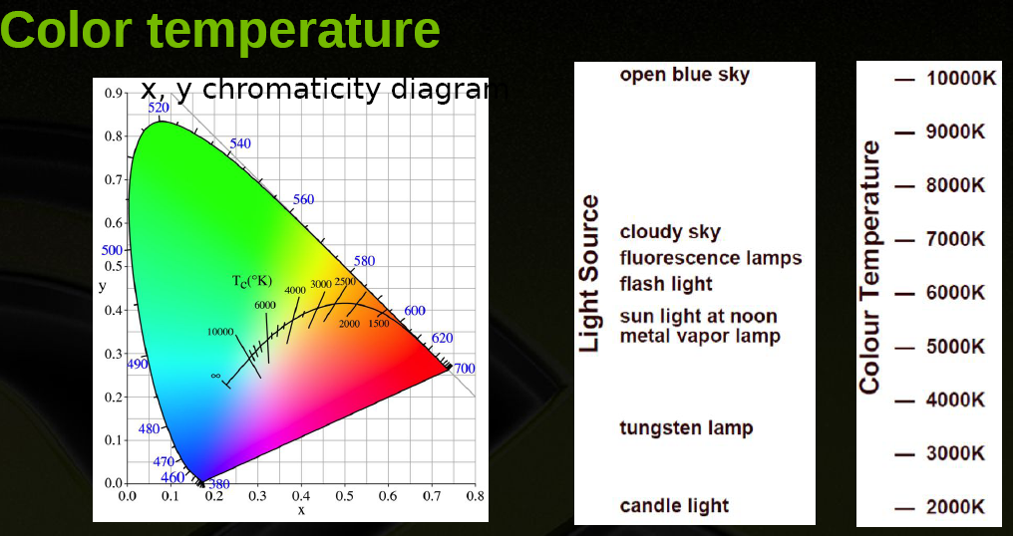

Slide 34
一般来讲,camera提供4档色温色彩校正,来实现普通应用场合的相机的自动白平衡.
CIE XYZ色彩空间和sRGB的转换关系.
Algorithms:
Gray world
“Simplest color balance” – histogram normalization with saturation
Robust auto white-balance
Sensor correlation illuminant estimation

Slide 35
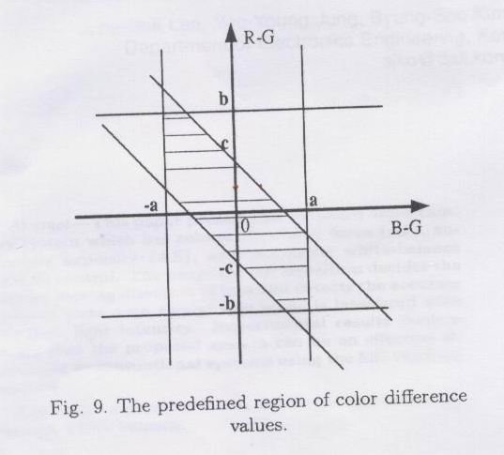
Using the color difference signals (R-G,B-G). Adjust the R gain & B gain let R-G & B-G go into the shaded area.
-a<B-G<a
-b<R-G<b
-c<(R-G)+(B-G)<c

Slide 36
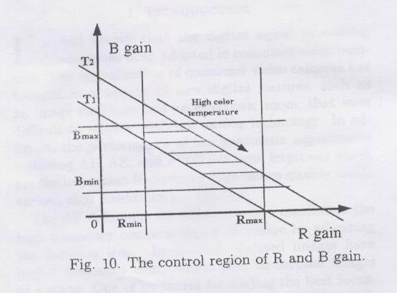
Color compensation convert the R and B gains into appropriate values with narrow shaded areas.
Rmin<R<Rmax
Bmin<B<Bmax
T1<R+3B<T2

Slide 37
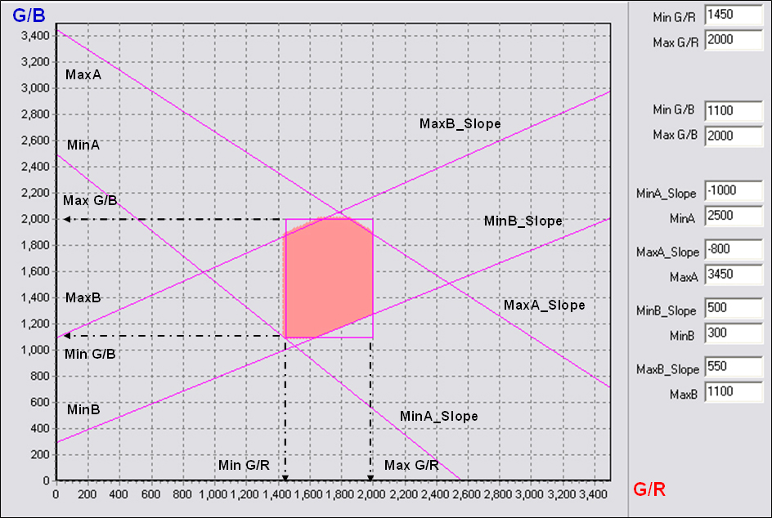

Slide 38
The number (Counter) of the pixels which satisfy the following conditions and their sums (Rsum, Gsum and Bsum)) of red, green and blue are calculated along with image data stream.
YbotReg<Y<YtopReg
Abs(I)<ItopReg
Abs(Q)<QtopReg
To deal with the issue of big region of uniform color, we will add the following judgment
if (Counter>=TH_GRAY_COUNT) //there is enough valid gray pixels
To update RGain, BGain to adjust AWB
else //there is not enough gray pixels
Keep the Rgain, BGain of the last frame.

Slide 39
The average value (AwbRmean, AwbGmean and AwbBmean) of the tricolor is calculated by the following formulas:
AwbRmean=Rsum/Counter
AwbGmean=Gsum/Counter
AwbBmean=Bsum/Counter
RDiff = abs( AwbRmean-AwbGmean )
BDiff = abs( AwbBmean-AwbGmean )
Based on these differences, Rgain and Bgain will be updated. AWB range control register (AWB threshold1, AWB threshold2, AWB gain step) will control this operation.

Slide 40
Auto White Balance
0 AWB threshold1 AWB threshold2
Rstep = 0 Rstep = 1 Rstep = AwbStep
RgainReg – Rstep ( AwbRmean>AwbGmean)
RgainNew =
RgainReg + Rstep ( AwbRmean<AwbGmean)
BgainReg – Bstep ( AwbBmean>AwbGmean)
BgainNew =
BgainReg + Bstep ( AwbBmean<AwbGmean)

Slide 41
Advance Auto White Balance
Data path
Stage 1: The task is to adjust the R/G/B balance to an “acceptable” degree.
Stage 2: The task is to further fine-tune the R/G/B balance to make it better.

Slide 42
Advance Auto White Balance
1. Stage 1 of the AAWB
For each frame, IC will collect the statistics of one light source, i.e., the number of pixels falling into the region of that light source model, denoted by p_data[i]
p_light_weight[i] = p_data[i]>>COUNTER_SHIFT;
b) After every 5 frames, IC will send an interrupt to firmware, saying 5 statistics are ready. With these 5 new statistics, firmware will perform the following smoothing operations, to reduce the unpleasing effect caused by erroneous statistics:
for( i=0; i<SOURCE_LIGHT_NUMBER; i++)
weighted[i]=(cur_weight*p_light_weight[i]
+(8-cur_weight)*short_pre_weights[i])/8;
for(i=0; i<SOURCE_LIGHT_NUMBER; i++)
short_pre_weights[i]=weighted[i];

Slide 43
Advance Auto White Balance
1. Stage 1 of the AAWB
c) Firmware will apply the smoothed weights on the pre-defined pre_gr_gain and pre_gb_gain to get the weighted gain values: gr_gain and gb_gain. As a by-product, we can also know the light source corresponding to the maximum weight.
d) Firmware will combine the weighted gains into color matrix, and write the new color matrix values into IC registers. 6 multiplications will be involved.

Slide 44
Advance Auto White Balance
2. Stage 2 of the AAWB
a) Calculate Rmean, Gmean, Bmean of the output from stage 1, satisfying both of the following conditions:
rr<=TH_RGB && gg<=TH_RGB && bb<=TH_RGB
Y>=YbotReg && Y<=YtopReg && abs(I)<ItopReg && abs(Q)<QtopReg
At the same time, count the number of pixels satisfying both of the conditions.
b) Calculate gain_gr, gain_gb:
gain_gr=64*Gmean/Rmean,
gain_gb=64*Gmean/Bmean.
c) If the count in step a) exceeds a threshold TH_GRAY_COUNT, it means there are enough gray pixels in the image, thus gain_gr and gain_gb are reliable statistics. In this case, we will further smooth them with previous values:
pre_gr_gain = (pre_gr_gain*3 + gain_gr + 2)/4;
pre_gb_gain = (pre_gb_gain*3 + gain_gb + 2)/4;

Slide 45
Advance Auto White Balance
3. How to get the Statistics
a) Get the luminance Y from RGB:
Y = ( 77*r + 150*g + 29*b ) / 256;
For those pixels satisfying (Y≥YbotReg) && (Y≤YtopReg) :
b) Transform RGB color space to log(g/b), log(r/b) space with an LUT: horizontal axis is log(g/b), and vertical axis is log(r/b);
x = log(g) – log(b);
y = log(r) – log(b);
c) Rotate x_y space by 45 degree.
y’=y-x;
x’=y+x;
Gray model under 4 Light sources
545
540
535
530
A
D65
525
CWF
520
515
510
505
500
Indoor
510
520
530
540
550
560
570
580
590
600
610

Slide 46
算法实现例子:
/* At this point, the average Y value and target Y value are used to calculate the adjustment ratio to cur AE settings Q10 format is used here to allow enouth accuracy */
adjRatio = h->targetBrightness * 1024 / curY;
adjRatio = (((adjRatio - 1024)*7)>>3) + 1024;
/* adjust the ratio according to number of smooth steps */
if(h->numSmoothSteps > 1)
adjRatio = (adjRatio - 1024)/(int)h->numSmoothSteps + 1024;
Adjustaecontrol();
/* Use the range values to calculate the actual adjustment needed */
for(i = 0; i < h->numRanges && adjRatio != 1024; i ++)
{
/* first decide which parameter to change */
if(h->exposureTimeRange[i].max > h->exposureTimeRange[i].min)
{
temp = newExposureTime;
newExposureTime = ((adjRatio * newExposureTime + 512) >> 10)/ h->exposureTimeStepSize * h->exposureTimeStepSize;
...........
/* update the adjRatio here */
adjRatio = (adjRatio * temp + (newExposureTime >> 1))/newExposureTime;
}
else if(h->sensorGainRange[i].max > h->sensorGainRange[i].min)
{
temp = newSensorGain;
newSensorGain = (adjRatio * newSensorGain + 512) >> 10;
..............
/* update the adjRatio here */
adjRatio = (adjRatio * temp + (newSensorGain >> 1))/ newSensorGain;
}
else if(h->apertureLevelRange[i].max > h->apertureLevelRange[i].min)
{
temp = newApertureLevel;
newApertureLevel = (adjRatio * newApertureLevel + 512) >> 10;
............
/* update the adjRatio here */
adjRatio = (adjRatio * temp + (newApertureLevel >> 1)) / newApertureLevel;
}
else if(h->ipipeGainRange[i].max > h->ipipeGainRange[i].min)
{
temp = newIpipeGain;
newIpipeGain = (adjRatio * newIpipeGain + 512) >> 10;
...........
/* update the adjRatio here */
adjRatio = (adjRatio * temp + (newIpipeGain >> 1)) / newIpipeGain;
}
}
/* Ae From ti*/

Slide 47
void AutoFocus(const Frame &f)
{
if (state == FOCUSED || state == IDLE) { return; }
if (state == SETTING) if (!lens->focusChanging()) state = FOCUSED; return;
// we're sweeping or homing
if (!f.sharpness().valid()) { return; }
……………………………………..
Stats s; s.position = f["lens.focus"]; s.sharpness = 0;
for (int sy = minSy; sy <= maxSy; sy++)
for (int sx = minSx; sx <= maxSx; sx++)
s.sharpness += f.sharpness()(sx, sy) >> 10;
stats.push_back(s);
if (state == HOMING && !lens->focusChanging())
// wait until we get a frame back with focus at infinity
if (fabs(s.position - lens->farFocus()) < 0.01)
{
lens->setFocus(lens->nearFocus(), (lens->nearFocus() - lens->farFocus()));
state = SWEEPING;
return;
}
if (state == SWEEPING && stats.size() > 4)
{
bool gettingWorse = true;
// check if the sharpness is just getting continuously worse (by at least 1% per tick). If so, don't wait for the sweep to terminate
for (size_t i = stats.size()-1; i > stats.size()-4; i--)
if (stats[i].position < stats[i-1].position ||(stats[i].sharpness*101)/100 > stats[i-1].sharpness)
{
gettingWorse = false;
break;
}
// Check if it's time to set the focus
if (!lens->focusChanging() || gettingWorse)
{
Stats best = stats[0];
for (size_t i = 1; i < stats.size(); i++)
{
if (stats[i].sharpness > best.sharpness) { best = stats[i]; }
}
lens->setFocus(best.position);
state = SETTING;
stats.clear();
return;
}
}
if (state == SETTING && !lens->focusChanging())
{
state = FOCUSED;
return;
}
}
/* af from dcam*/

Slide 48
static u8 awb_gray_world_mode(awb_data_t * pTileInfo, wb_gain_t* pNextGain)
{
u32 i;
u8 awb_no_whites=1;
u32 r_value, r_sum, g_value, g_sum, b_vlaue, b_sum, rAvg, gAvg, bAvg, liny, rgbCnt=0;
r_sum = 0;
g_sum = 0;
b_sum = 0;
for (i = 0; i<awbTileNum ; i++)
{
r_value = pTileInfo[i].r_avg>>6;
g_value = pTileInfo[i].g_avg>>6;
b_vlaue = pTileInfo[i].b_avg>>6;
liny = pTileInfo[i].lin_y;
if(r_value>0 && b_vlaue>0 && g_value>0 && liny>10 && liny<50)
{
r_sum += r_value;
g_sum += g_value;
b_sum += b_vlaue;
rgbCnt++;
}
}
if (rgbCnt > 0 )
{
rAvg= r_sum / rgbCnt;
gAvg= g_sum / rgbCnt;
bAvg= b_sum / rgbCnt;
if(rAvg > 0 && bAvg > 0)
{
pNextGain->r_gain = gAvg * UNITGAIN/ rAvg;
pNextGain->g_gain= UNITGAIN;
pNextGain->b_gain= gAvg * UNITGAIN/ bAvg;
}
awb_no_whites= 0;
}
return (awb_no_whites);
}
/*awb */

Slide 49
Thank you for your attention!

